Slide 1


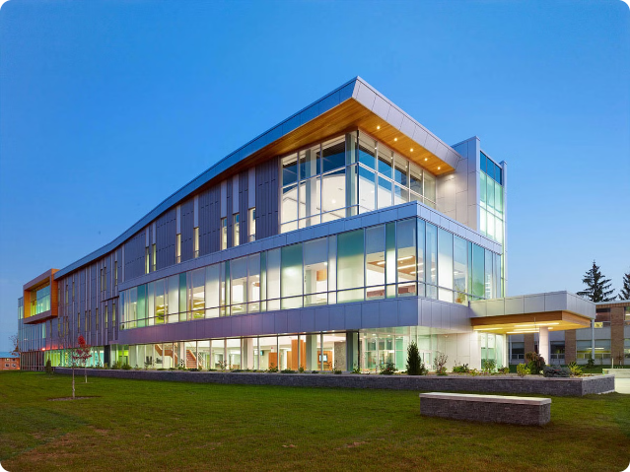
Streamline Admissions: A Modern Approach
Welcome to our innovative admissions process. We're making it easier for prospective students to connect with us and stay informed every step of the way.

Slide 2

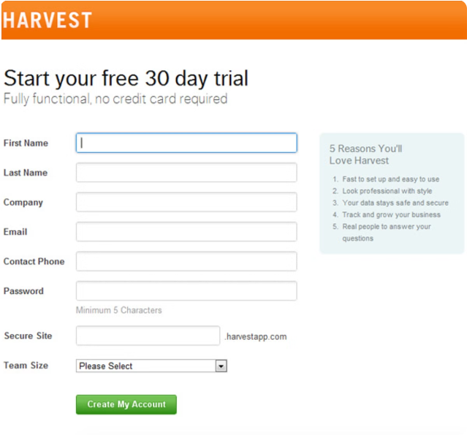
Easy Inquiry Form
Quick & Easy
Our user-friendly online form takes just a few minutes to complete.
Secure Information
Your personal information is securely stored and protected.
Stay Connected
Receive timely updates on your application status via email, WhatsApp and SMS.

Slide 3


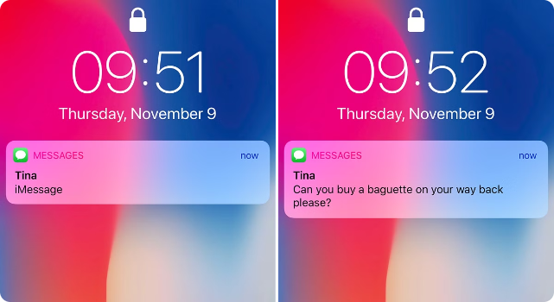

Automated Communication
WhatsApp Notifications
Stay informed about important deadlines and application updates through instant WhatsApp messages.
SMS Reminders
Receive SMS notifications for those without WhatsApp, ensuring everyone stays up-to-date.

Slide 4

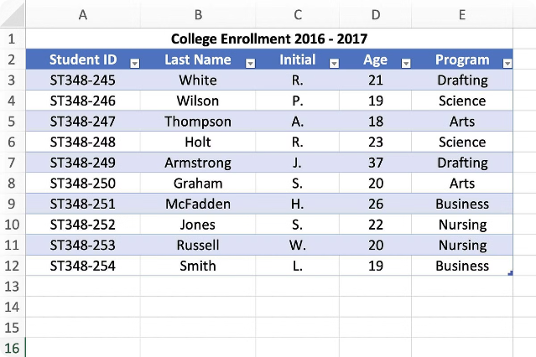
Centralized Data Management
Student Name
Contact Details
Email Address
John Doe
123-456-7890
john.doe@email.com
Jane Smith
987-654-3210
jane.smith@email.com

Slide 5
Administrator Interface
Student Management
Mass Messaging
Merit List Management
Administrators can view and manage student application data, ensuring efficient processing and tracking.
Send personalized messages to all students or specific groups with ease using the built-in messaging platform.
Publish merit lists and send personalized notifications to shortlisted candidates and those awaiting further results.

Slide 6





Merit List Notification
Shortlisted Candidates
Receive a congratulatory message and instructions for confirming admission.
Waitlist
Notification about being on the waitlist and instructions for future merit list updates.
No Selection
Notification about admission seats being full and information about future application cycles.

Slide 7


Simplified Communication
1
Reduced Wait Time
Students receive timely updates, reducing anxiety and improving their experience.
2
Enhanced Transparency
The system provides clear and consistent communication to all students.
3
Improved Efficiency
Administrators can manage the admission process more efficiently.
4
Increased Accessibility
The system is accessible to all students, regardless of their access to traditional communication channels.

Slide 8

Thank You For Listening
We appreciate you taking the time to review our presentation on modernizing the admissions process. We hope we've demonstrated how our innovative solution can streamline communication, improve transparency, and enhance the student experience.

